Slide 1
WELCOME TO MY WORLD
Ewura Abena Antwi-Bosiako

Slide 2
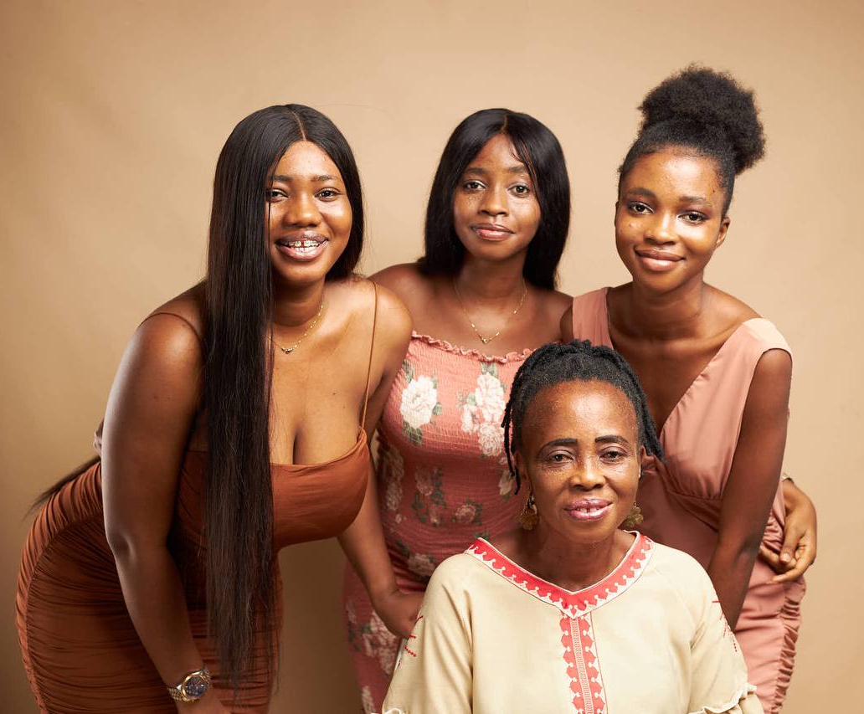
A LITTLE ABOUT ME
My name is Ewura Abena Tweneboah Antwi-Bosiako
I was born on the 12th of October 2004
I was born and raised in Accra
I come from a small nuclear family with two sisters

Slide 3
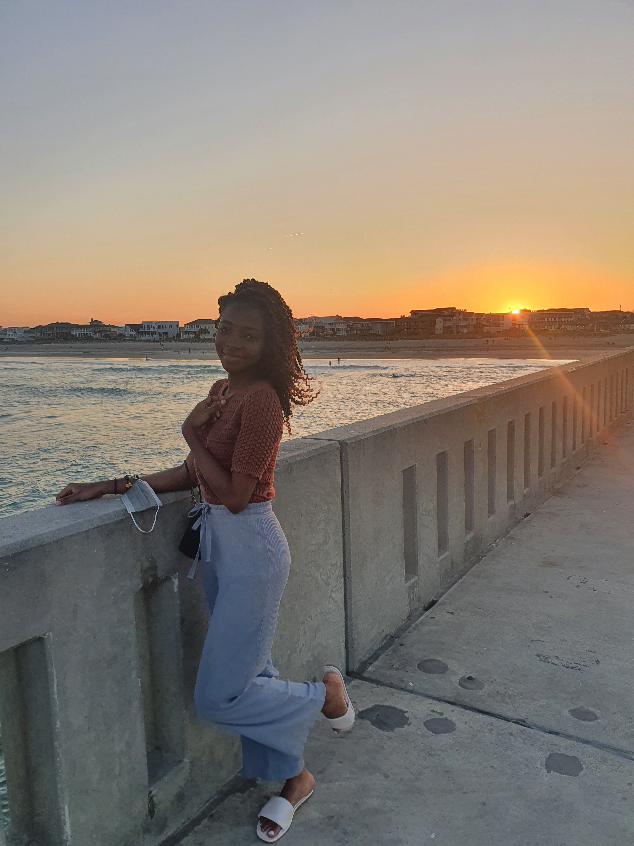
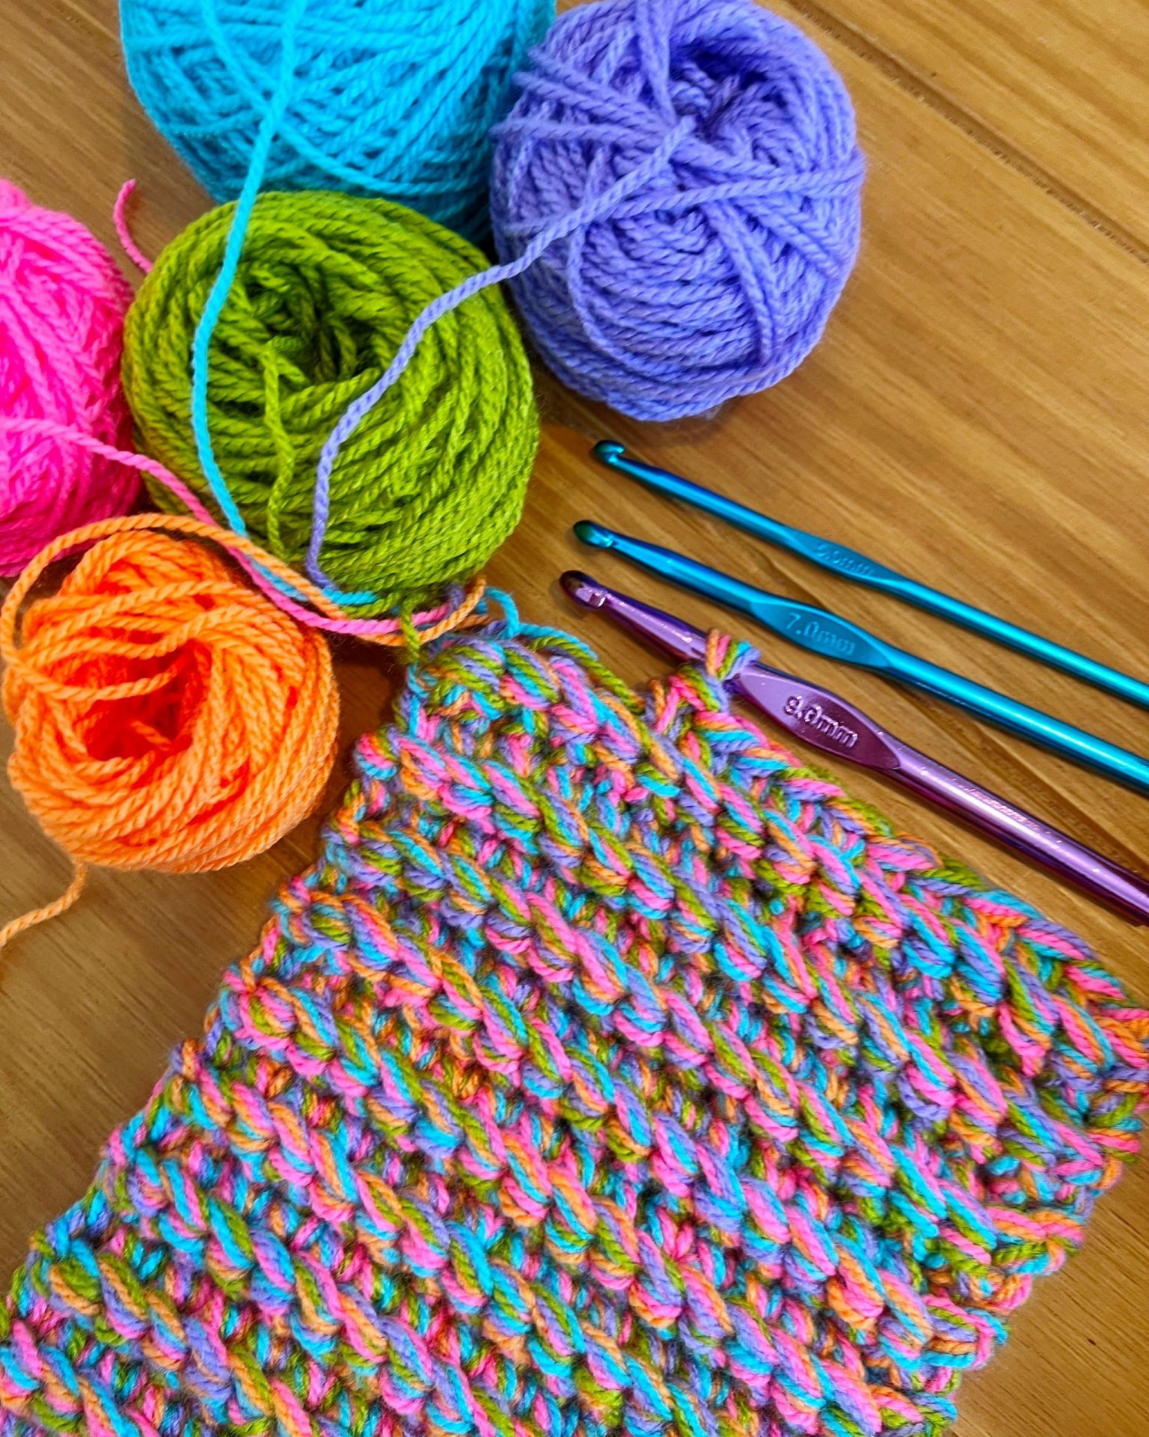
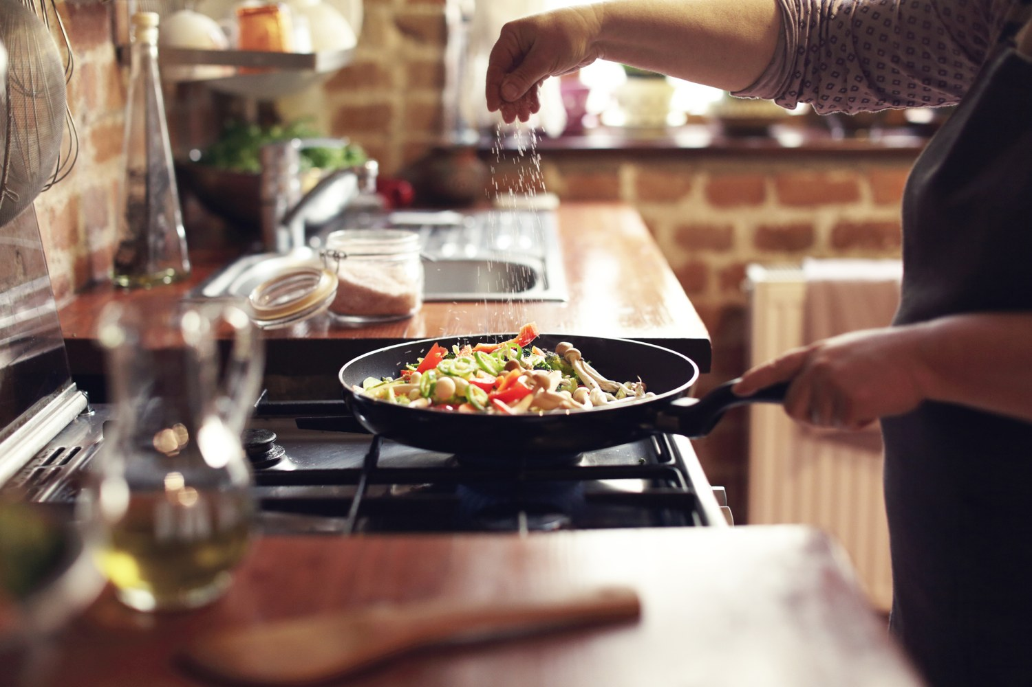
MY HOBBIES
Travelling and Sightseeing
Learning new skills (crocheting)
Cooking
Watching movies, shows, docuseries

Slide 4

EDUCATION
I am currently a student at the University of Ghana, Legon main campus
I am pursuing a Bachelors of Science in Information Technology
I am a non-resident student

Slide 5
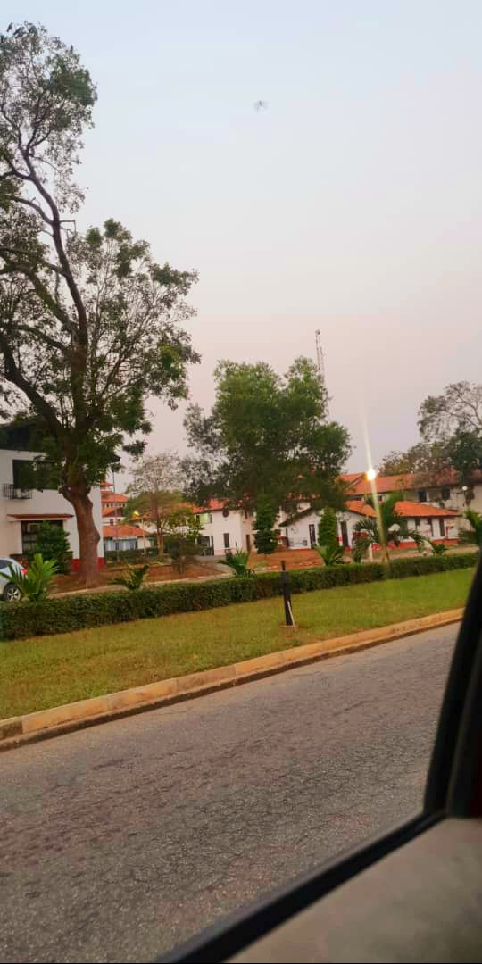
UNIVERSITY OF GHANA
The University of Ghana is the premier university in Ghana
It was founded on August 11 1948
It has a collegiate system comprising of four colleges
College of Health Sciences
College of Basic and Applied Sciences
College of Humanities
College of Education
Each college is subdivided into Schools and each school is sub-divided into departments

Slide 6

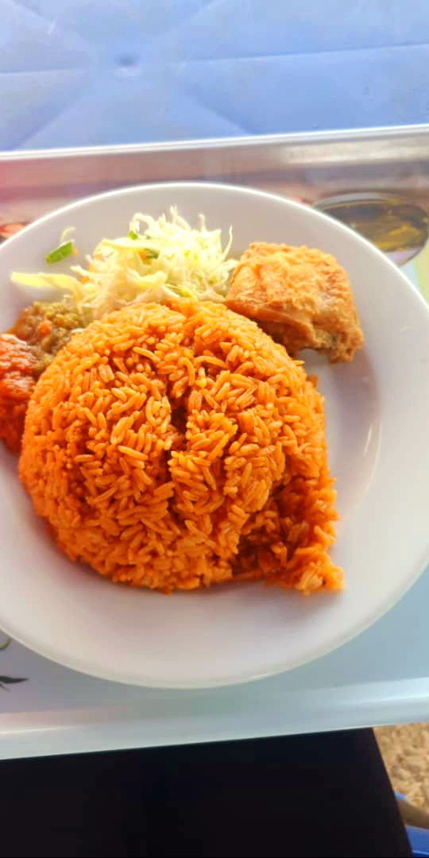
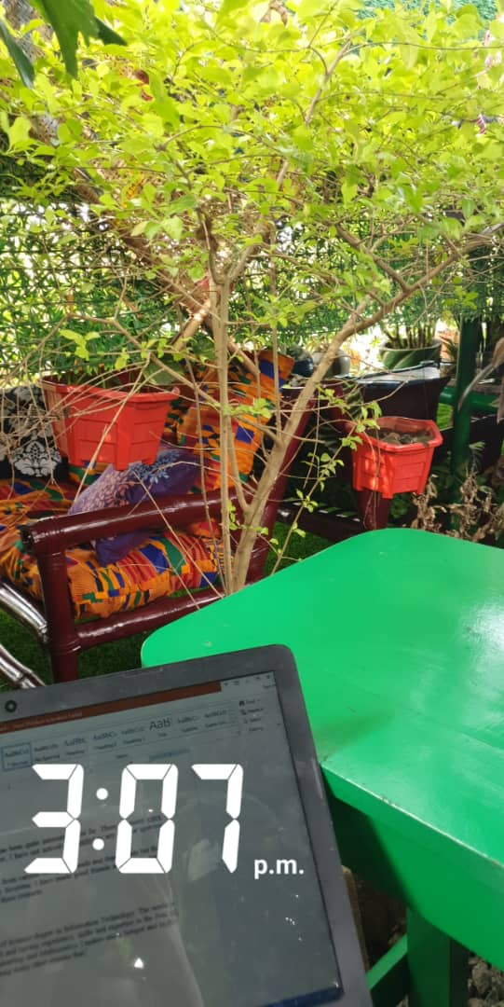
CAMPUS LIFE
My favorite spots on campus are
Commonwealth Basket Market
Maths Cafeteria
McJean’s Catering cafeteria
Mathematics Library
Business School library

Slide 7
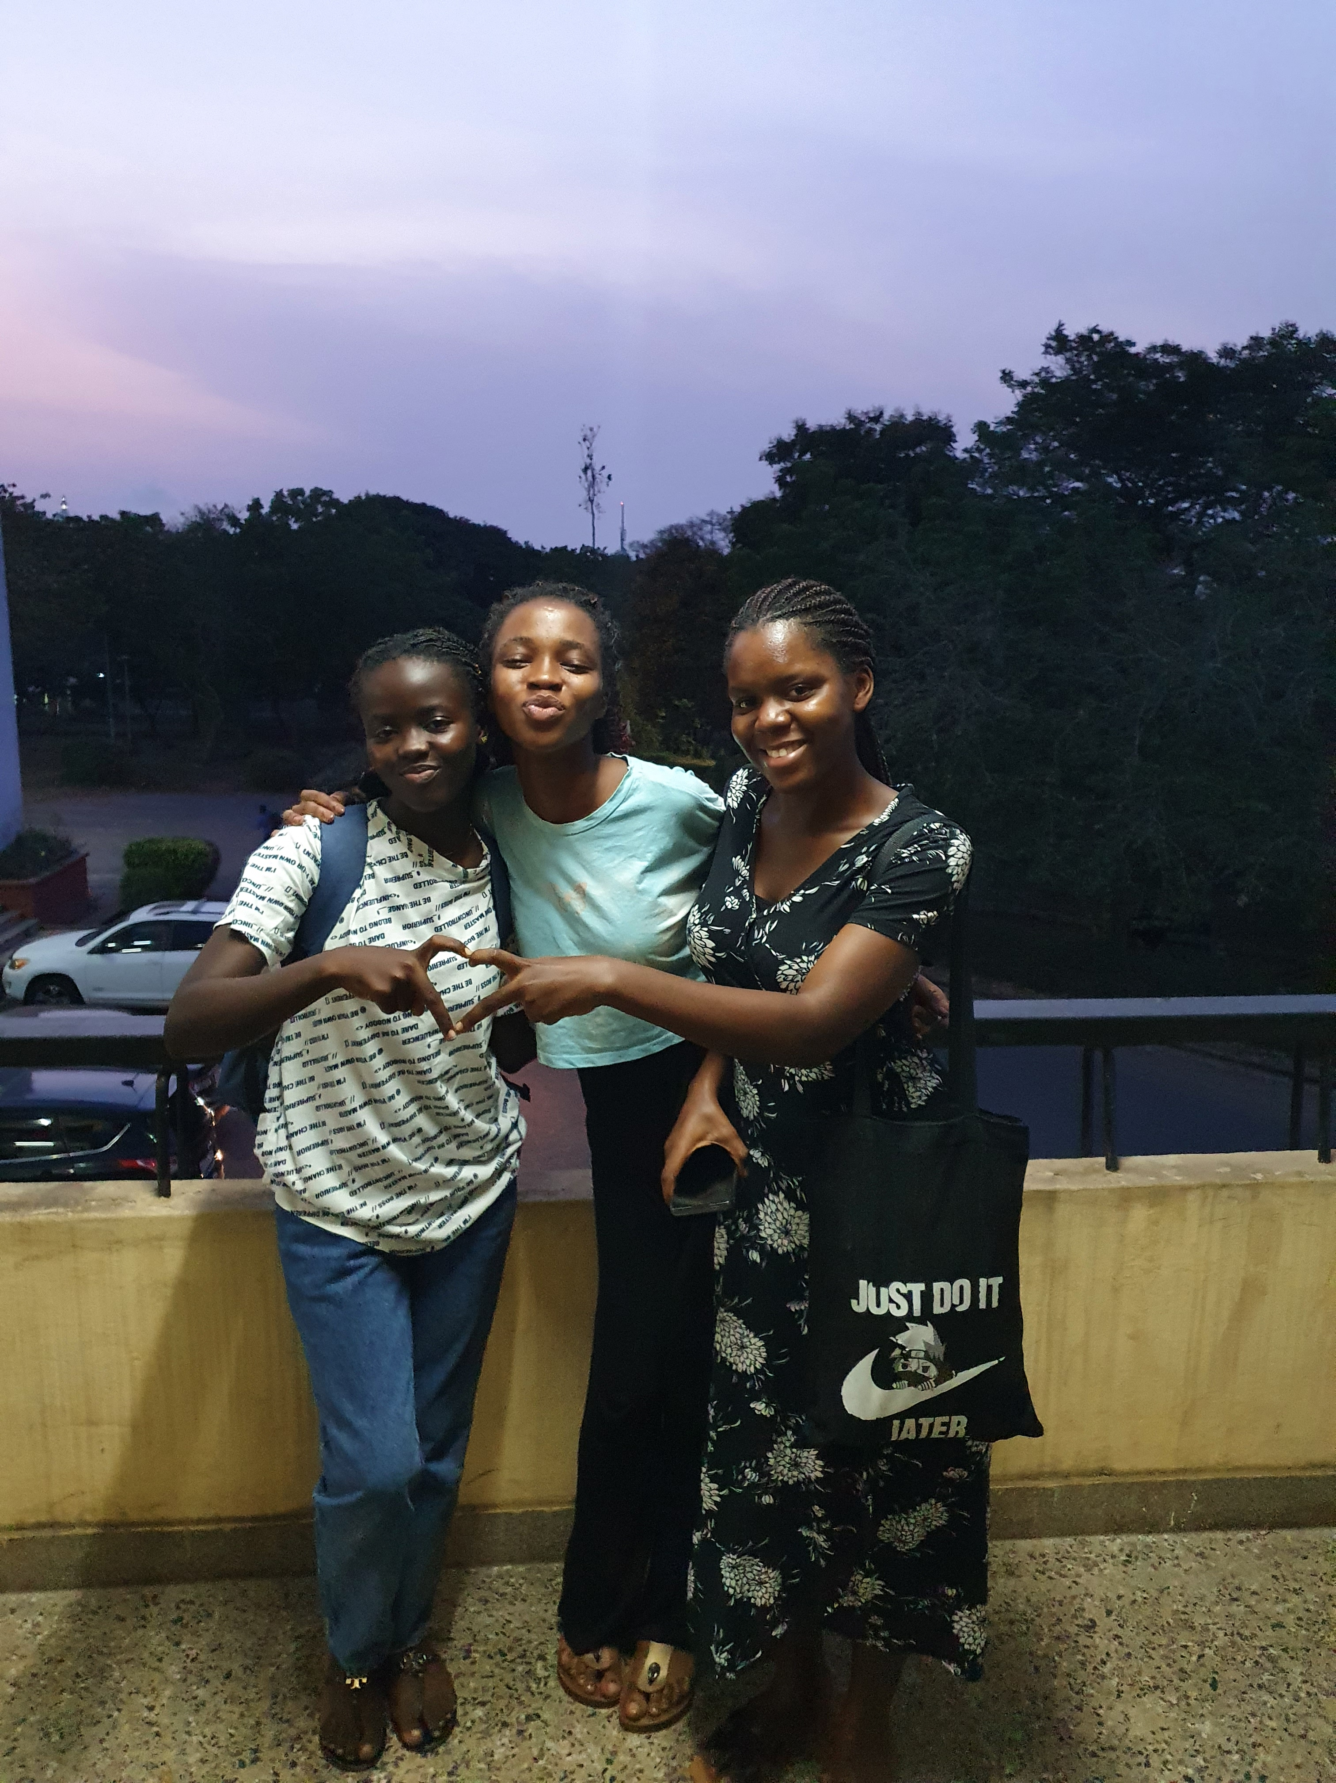
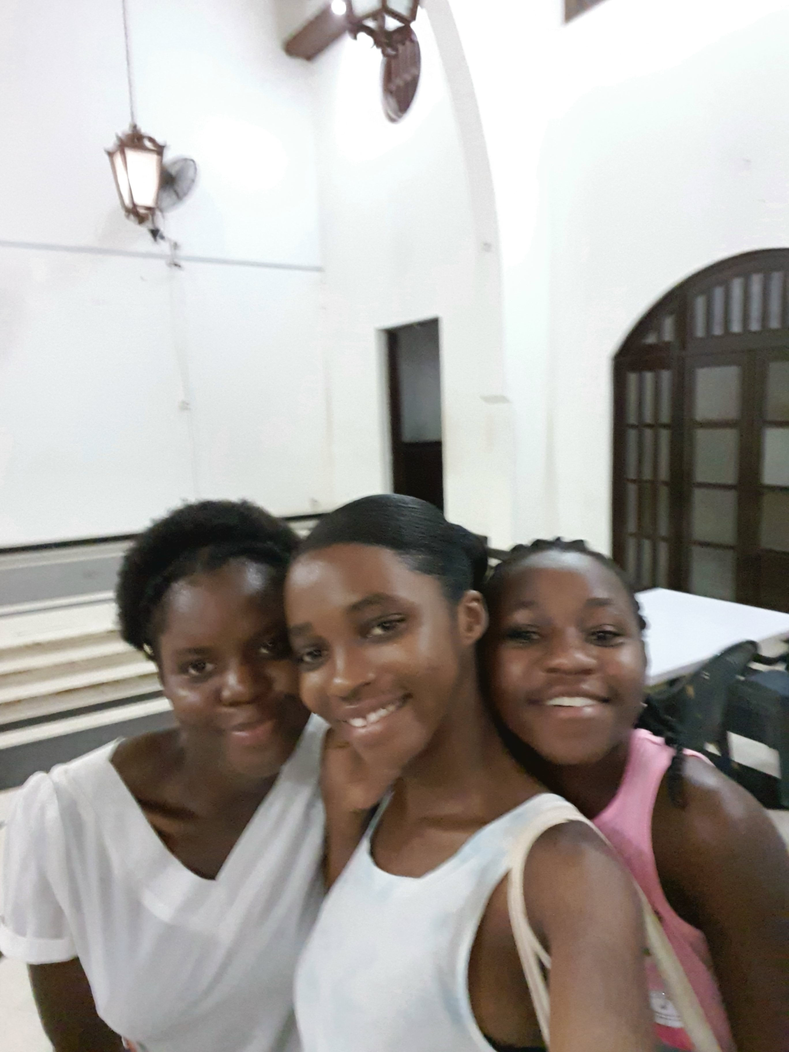
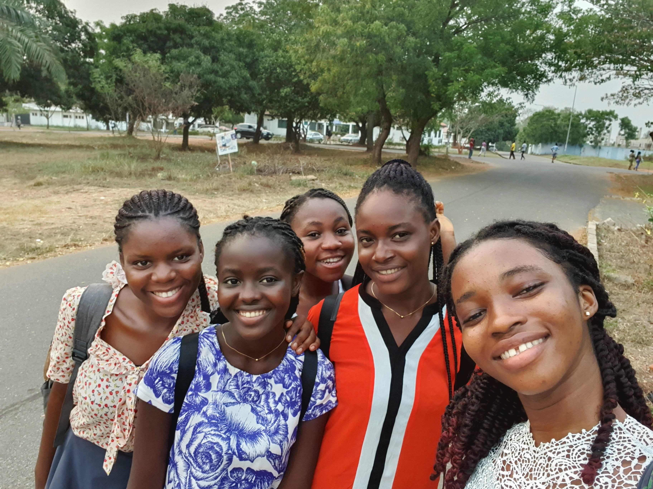
FRIENDSHIPS AND RELATIONSHIPS
I have met many amazing people on campus

Slide 8
ECON101 Introduction to Economics
This semester, I take 6 courses which are
DCIT101 Intro to Computer Science
ECON101 Introduction to Economics
UGRC150 Critical thinking and Practical reasoning
DCIT103 Office Productivity Tools
DCIT105 Mathematics for IT Professionals
STAT111 Introduction to Statistics

Slide 9

DCIT103
This is the Office Productivity tools
It is delivered by Sir Mark Attah Mensah
Eselasie Nobleson is the Teaching Assistant
This course seeks to equip students with skills in 3 major software
Word Processing software
Spreadsheet software
Presentation software
The mode of course delivery is entirely online both for main lectures and tutorials

Slide 10
Each module of the subject has the following
A General Assignment
A Self assessment
A quiz
A capstone project
The various capstone projects sum up to make the Interim assessment of the Final grade

Slide 11
RECOMMENDATION?
CLASS SHOULD BE FACE TO FACE

Slide 12
THANK YOU

